Slide 1

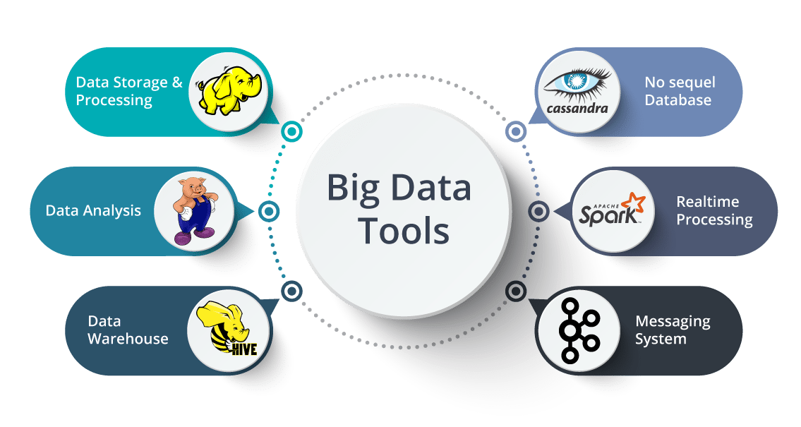
Big Data Storage and Processing MSc in Data Analytics CCT College Dublin
Hadoop Distributed File System (HDFS)
Week 2
Lecturer: Dr. Muhammad Iqbal*
Email: miqbal@cct.ie

Slide 2

Agenda
Introduction
Hadoop Design Goals
Hadoop Concepts
Hadoop Dataflow
Hadoop Proximity
Hadoop Replication

Slide 3
Introduction
What is Hadoop?
An open-source software platform for distributed storage and distributed processing of very large data sets on computer clusters built from commodity hardware. Hortonworks
Hadoop Distributed File System (HDFS)
When a dataset outgrows the storage capacity of a single physical machine, it becomes necessary to partition it across a number of separate machines.
Filesystems that manage the storage across a network of machines are called distributed filesystems.
Storage requirements necessitate partitioning datasets across a number of machines.
Can we ensure filesystem tolerance to a node failure?
Notes:
When a dataset outgrows the storage capacity of a single physical machine, it becomes necessary to partition it across a number of separate machines. Filesystems that manage the storage across a network of machines are called distributed filesystems. Since they are network based, all the complications of network programming kick in, thus making distributed filesystems more complex than regular disk filesystems. For example, one of the biggest challenges is making the filesystem tolerate node failure without suffering data loss.

Slide 4
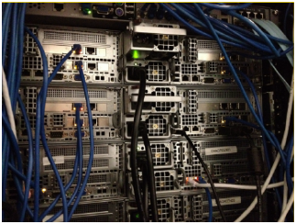
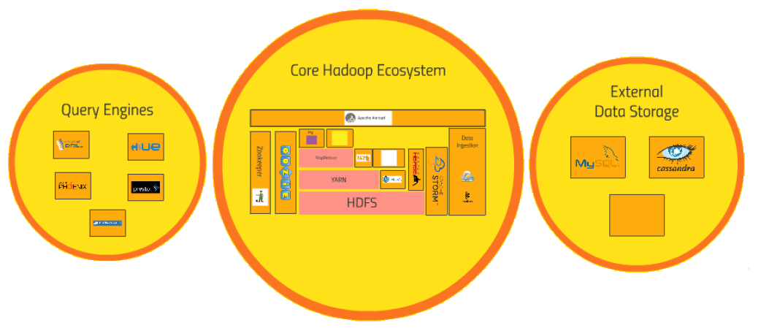
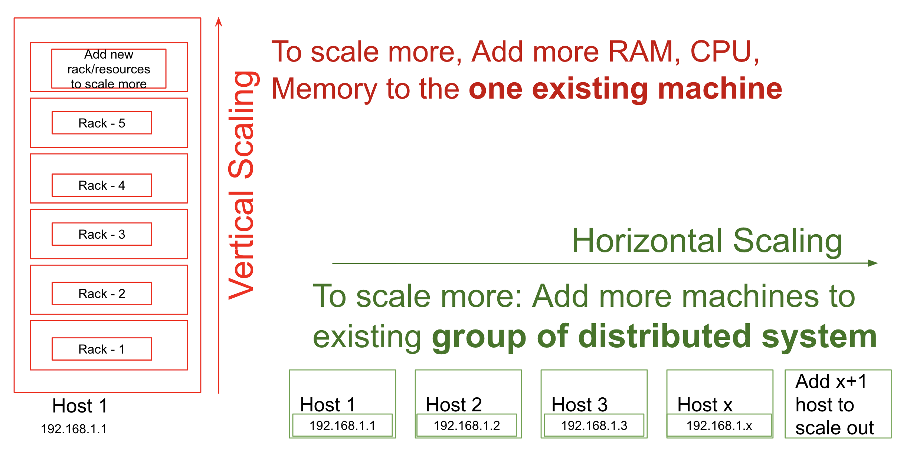
Why Hadoop?
Data's too darn big - Terabytes per day
Vertical scaling doesn't cut it
Disk seek times
Hardware failures
Processing times
Horizontal scaling is linear.
Hadoop: It's not just for batch processing anymore.
HDFS is horizontally scalable.

Slide 5
Hadoop Design Goals
Hadoop distributed file system (HDFS) is designed
to handle very large datasets
be deployed on commodity hardware
exhibit a high level of fault tolerance
enable streaming access to filesystem data
Megabytes – Terabytes - Petabytes
High chance of node failure
In case of node failure
Write-once, read-many pattern – time to read whole file more important than latency in reading the first record
Notes:
HDFS will not work as well for
Low-latency data access (i.e., tens of milliseconds)
HBase can provide a better choice for low-latency data access
Large number of smaller files
Filesystem metadata is held in memory at namenodes
Limit to number of files in a filesystem is a function of namenode memory capacity
Multiple writes and arbitrary file modifications
Files in HDFS written to by a single writer
Writes are made at the end of a file

Slide 6
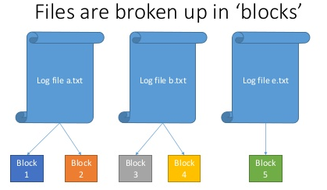
Hadoop Concepts Blocks
We are familiar with block I/O at the disk level
Filesystems implement a block size which is typically an integral multiple of the disk block size, e.g.
HDFS also implements a block size
128MB by default
HDFS files are broken up into block sized chunks which can then be stored as independent units.
Note: A HDFS file that is smaller than the HDFS block will not take up a full block of space – all blocks in a file are the same size except possibly for the last one.
Disk Block Size | Filesystem Block Size
512 Bytes | 4 Kilobytes
Why such large HDFS block sizes?
Notes:
In Hadoop, HDFS splits huge files into small chunks known as data blocks. HDFS Data blocks are the smallest unit of data in a filesystem. ... However, the data block size in HDFS is very large. The default size of the HDFS block is 128MB which you can configure as per your requirement.
The Difference Between Disk Block and File Limits
A file system provides two resources to the user, blocks for data and inodes for files. Each file consumes one inode. File data is stored in data blocks. Data blocks are usually made up of 1Kbyte blocks.
Assuming no directories exist, a user can exceed his or her inode quota by creating all empty files without using any blocks. A user can also use one inode, yet exceed his or her block quota, by creating one file that is large enough to consume all the data blocks in the user's quota.

Slide 7
Hadoop Concepts Blocks
HDFS blocks are large to reduce the cost of seek operations.
We would like the time taken to transfer data from the disk to be as close as possible to the disk transfer rate.
Reduce the percentage time spent doing seek operations
If the seek time is approximately 10ms for a disk with a transfer rate of 100MB/s then to make the seek time 1% of the total transfer time, the block should be configured to approximately 100MB.

Slide 8
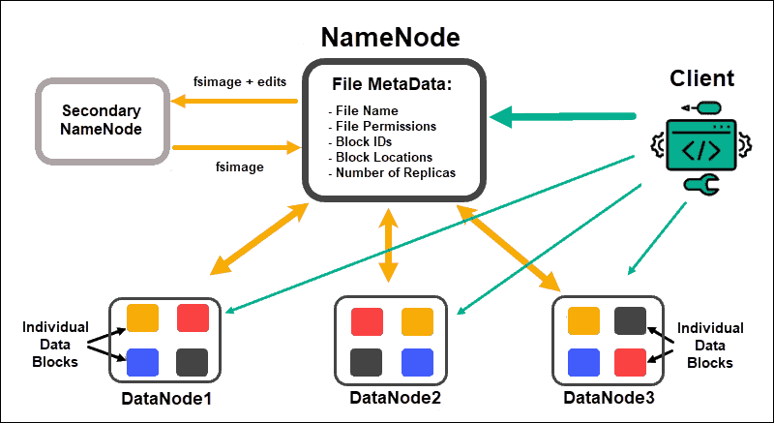
Hadoop Concepts
Namenodes and Datanodes
HDFS has a master/ slave (or master/ worker) architecture
A namenode is the master
A set of datanodes act as the slaves or workers
Source: https://phoenixnap.com/kb/apache-hadoop-architecture-explained

Slide 9
Hadoop Concepts The Namenode
Maintains the filesystem tree and the metadata for the files and directories in the tree
Stored persistently on disk in the form of two files:
The namespace image (FSImage file) – filesystem namespace, file-block mappings, filesystem properties – 4GB RAM should be plenty for large filesystem
The edit log (EditLog file) – a transaction log
The namenode also knows the datanodes on which all the blocks for a given file are located
This information is reconstructed from the datanodes when the system starts
SPOF?
Notes:
A HDFS cluster has two types of nodes operating in a master−worker pattern: a namenode (the master) and a number of datanodes (workers). The namenode manages the filesystem namespace. It maintains the filesystem tree and the metadata for all the files and directories in the tree. This information is stored persistently on the local disk in the form of two files: the namespace image and the edit log. The namenode also knows the datanodes on which all the blocks for a given file are located; however, it does not store block locations persistently, because this information is reconstructed from datanodes when the system starts.
A single point of failure (SPOF) is a part of a system that, if it fails, will stop the entire system from working. SPOFs are undesirable in any system with a goal of high availability or reliability, be it a business practice, software application, or other industrial system.
EditLogs is a transaction log that records the changes in the HDFS file system or any action performed on the HDFS cluster such as addition of a new block, replication, deletion etc. In short, it records the changes since the last FsImage was created.

Slide 10
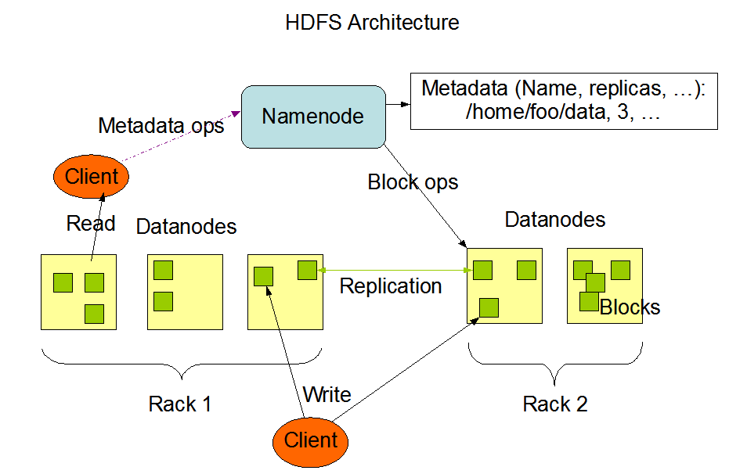
Hadoop Concepts The datanode
For every node (Commodity hardware/ System) in a cluster, there will be a datanode. These nodes manage the data storage of their system.
Handle read/ write requests from clients (or the namenode).
They also perform operations such as, block creation, deletion, and replication according to the instructions of the namenode.
Usually, one datanode per node in the cluster.
Note: User data does not flow through the namenode.
Namenodes and Datanodes
Notes:
Commodity computing involves the use of large numbers of already-available computing components for parallel computing, to get the greatest amount of useful computation at low cost. It is computing done in commodity computers as opposed to in high-cost superminicomputers or in boutique computers.

Slide 11
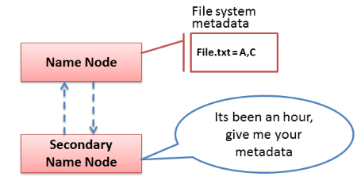
Hadoop Concepts HDFS High Availability
NameNode Failure
Replication of persistent state to remote Network File System (NFS) mount
Secondary NameNode (deprecated)
Checkpoint Node
Backup Node
Hadoop provides HDFS HA via active-passive standby configuration
SPOF?
Active / Standby – should be machines with equivalent specifications
DataNodes send heartbeat and blockreports to both Active and Standby nodes
Notes:
SPOF Issue: If the NameNode failed in earlier Hadoop versions (before Hadoop 2.x), no other node would have the metadata required to recreate the file system, making the entire HDFS unreachable. Mitigation: High Availability (HA) for the NameNode was introduced in Hadoop 2.x. There are two NameNodes in a high availability (HA) configuration: an active and a standby. All client requests are handled by the current NameNode, and a shared edit log keeps the backup NameNode in sync. The backup NameNode takes over in the event that the active NameNode fails, removing the SPOF.
JobTracker (in Hadoop 1.x) Role: In Hadoop's MapReduce 1.0, the JobTracker was in charge of scheduling jobs and managing resources. It managed how MapReduce jobs were carried out throughout the cluster. SPOF Problem: Because the JobTracker was a single master node, any failure would affect all active jobs, and until the JobTracker was restored, no new jobs could be planned. Mitigation: YARN (Yet Another Resource Negotiator) took the position of JobTracker in Hadoop 2.x. In order to share duties and lower the chance of a SPOF, YARN divides resource management, which is handled by the ResourceManager, from job scheduling, which is handled by the ApplicationMaster.

Slide 12
Hadoop Concepts HDFS High Availability
Secondary NameNode
Used to periodically merge the namespace image with the edit log file
Should run on a separate machine with same memory requirements as the NameNode
Keeps copy of the merged namespace image that can be used in the case of failure
Does not provide HA
Secondary namenode will lag the primary – high probability of data loss!
Notes:
In order for the Standby node to keep its state synchronized with the Active node, both nodes communicate with a group of separate daemons called “JournalNodes” (JNs). When any namespace modification is performed by the Active node, it durably logs a record of the modification to a majority of these JNs. The Standby node is capable of reading the edits from the JNs, and is constantly watching them for changes to the edit log. As the Standby Node sees the edits, it applies them to its own namespace. In the event of a failover, the Standby will ensure that it has read all of the edits from the JounalNodes before promoting itself to the Active state. This ensures that the namespace state is fully synchronized before a failover occurs.
In order to provide a fast failover, it is also necessary that the Standby node have up-to-date information regarding the location of blocks in the cluster. In order to achieve this, the DataNodes are configured with the location of both NameNodes and send block location information and heartbeats to both.
What is High Availability in HDFS?
The HDFS NameNode High Availability feature enables you to run redundant NameNodes in the same cluster in an Active/Passive configuration with a hot standby. This eliminates the NameNode as a potential single point of failure (SPOF) in an HDFS cluster.
How can you ensure High Availability of NameNode?
To provide a fast failover, the standby node must have up-to-date information about the location of data blocks in the cluster. For this to happen, IP address of both the namenode is available to all the datanodes and they send block location information and heartbeats to both NameNode.
[Source: Google Search Engine]

Slide 13
Hadoop Concepts HDFS High Availability
Checkpoint Node
Replaces the role of the Secondary NameNode.
Multiple Checkpoint Nodes can be configured as long as there is no Backup Node operational.
It performs periodic checkpoints of the namespace and helps to minimize the size of the log stored at the NameNode containing changes to the HDFS.
The NameNode allows multiple Checkpoint nodes simultaneously, as long as there are no Backup nodes registered with the system.
Does not provide HA
Notes:
Namenode stores the HDFS metadata in two files in its local filesystem: fsimage and edits file.
1. Fsimage contains the whole metadata info like namespace image of file system, Block mappings to file, etc.
2. Edits file contains all the changes made to the file system after the NameNode startup.
Once the Namenode starts, first it reads/constructs the namespace image of HDFS from fsimage, applies all the changes to it from edits file.
If the Namenode is running for a long time, it's next startup will take time as it has to apply large no. of changes via edits file. To overcome this, we have, Checkpoint Node: It periodically downloads fsimage and edits file from Namenode, merges it to a latest fsimage, and uploads it back to the Namenode.
Hence, during next startup of Namenode, it will construct it's metadata into Hadoop HDFS with the latest fsimage, and with an empty edits file.
Secondary Namenode: It is also same as Checkpoint node, but it doesn't upload the latest merged fsimage back to namenode and uploads it to a persistant storage. Hence, in case of Namenode failure, this latest fsimage from this storage can be used.

Slide 14
Hadoop Concepts HDFS High Availability
Backup Node
Performs checkpointing
Also receives a stream of edits from the NameNode and maintains its own in-memory copy of the namespace, which is always in sync with the active NameNode namespace state.
Only one Backup node may be registered with the NameNode at once.
facilitates warm standby possibility

Slide 15
Hadoop Dataflow File Read
Open FileSystem Object
Calls NameNode RPC
client node
namenode
client JVM
NameNode
1: open
DistributedFileSystem
HDFS client
2: get block location
3: read
6: close
FSDataInputStream
5: read
4: read
datanode
datanode
datanode
DataNode
DataNode
DataNode

Slide 16
Hadoop Dataflow File Read
Client NameNode DataNodes
Client calls open() on a FileSystem object (which is an instance of DistributedFileSystem)
DistributedFileSystem calls the namenode via RPC to determine locations of first few blocks in the file
For each block, the namenode returns the addresses of the datanodes that have a copy of that block
Datanodes are sorted according to proximity of client process
DistributedFileSystem returns a FSDataInputStream to the client
FSDataInputStream wraps a DFSInputStream which manages the namenode and datanode I/O
DistributedFileSystem Object = initialization
Notes:
In distributed computing, a remote procedure call (RPC) is when a computer program causes a procedure (subroutine) to execute in a different address space (commonly on another computer on a shared network), which is coded as if it were a normal (local) procedure call, without the programmer explicitly coding the details for the remote interaction. That is, the programmer writes essentially the same code whether the subroutine is local to the executing program, or remote. This is a form of client–server interaction (caller is client, executor is server), typically implemented via a request–response message-passing system. In the object-oriented programming paradigm, RPC calls are represented by remote method invocation (RMI).
1) DistributedFileSystem Object = initialization
2) Calls namenode using RPC and find the locations of first few blocks
3) Namenode returns the addresses of the datanodes
4) DistributedFileSystem returns FSDataInputStream to the client

Slide 17
Hadoop Dataflow File Read
Client NameNode DataNodes
The client then calls read() on the stream
DFSInputStream connects to the first datanode for the first block in the file
The client calls read() repeatedly on the stream
When the end of the block is reached, DFSInputStream closes the connection to the datanode and then finds the next datanode for the next block
DFSInputStream will make calls when necessary to get the datanode locations for subsequent batches of blocks
When the client has finished reading it calls close() on the FSDataInputStream

Slide 18
Hadoop Dataflow File Write
client node
namenode
client JVM
NameNode
1: create
DistributedFileSystem
2: create
HDFS client
7: complete
3: write
6: close
FSData
OutputStream
4: write packet
5: ack packet
datanode
datanode
datanode
DataNode
DataNode
DataNode

Slide 19
Hadoop Dataflow File Write
Client NameNode DataNodes
Client creates a file by calling create() on DistributedFileSystem
DistributedFileSystem calls the namenode via RPC to create a new file in the filesystem’s namespace (no blocks associated yet)
Namenode performs a series of checks to ensure file does not already exist and that client has required permissions
If checks pass namenode makes a record of the new file
DistributedFileSystem returns a FSDataOutputStream to the client
FSDataInputStream wraps a DFSOutputStream which manages the namenode and datanode I/O

Slide 20
Hadoop Dataflow File Write
Client NameNode DataNodes
As the client writes data DFSOutputStream splits it into packets which are written to an internal data queue
The data queue is consumed by a DataStreamer which is responsible for requesting the namenode to allocate new blocks by picking a suitable set of datanodes to store the replicas
The set of datanodes form a pipeline (assume 3 datanodes)
The DataStreamer streams the packet to the first datanode in the pipeline which stores the packet and forwards it to the second datanode
The second datanode stores the packet and forwards it to the third datanode
The DFSOutputStream also maintains an internal queue of packets that are waiting to be acknowledged by the datanodes – the ack queue
A packet is removed from the ack queue only when it has been acknowledged by all the datanodes in the pipeline

Slide 21
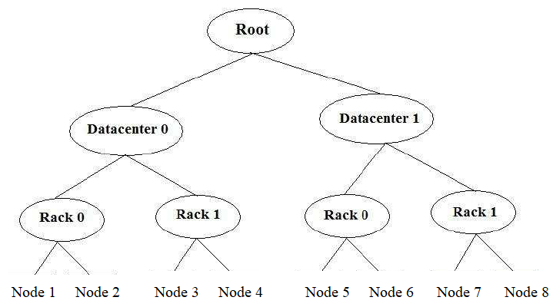
Hadoop Proximity Network Topology
Measure of node ‘closeness’.
Use bandwidth between nodes as a measure of closeness.
Network represented as a tree.
Distance between nodes is the sum of their distances to their closest common ancestor.
Commonly, levels in the tree correspond to the data-centre, the rack, and the node that the processing is running on.
Example:
Consider a node n1 on rack r1 in data-centre d1 being represented by /d1/r1/n1, Then
distance(/d1/r1/n1, /d1/r1/n1) = 0
distance(/d1/r1/n1, /d1/r1/n2) = 2
distance(/d1/r1/n1, /d1/r2/n3) = 4
distance(/d1/r1/n1, /d2/r3/n4) = 6
Notes:
Distance(/d1/r1/n1 , /d1/r1/n1) = 0 (process on the same node)
Distance(/d1/r1/n1 , /d1/r1/n2) = 2 (different nodes on same rack)
Distance(/d1/r1/n1 , /d1/r2/n3) = 4 (nodes on different racks in the same data center)
Distance(/d1/r1/n1 , /d2/r3/n4) = 6 (nodes on different data centers)
The main difference between a cloud and a data center is that a cloud is an off-premise form of computing that stores data on the Internet, whereas a data center refers to on-premise hardware that stores data within an organization's local network. ... Data center has the capacity of storing servers.
A rack is a collection of 30 or 40 nodes that are physically stored close together and are all connected to the same network switch. Network bandwidth between any two nodes in rack is greater than bandwidth between two nodes on different racks. A Hadoop Cluster is a collection of racks.
Note: A Hadoop installation should be configured to have a knowledge of the network topology

Slide 22
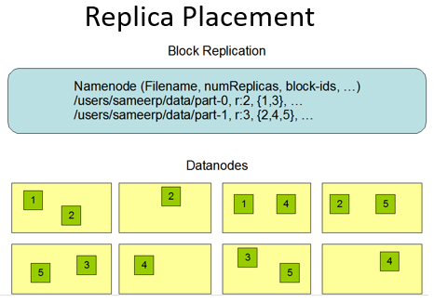
Hadoop Replication Replica Placement
Blocks replicated for fault-tolerance.
Application can specify the number of replicas required. Replication factor can be specified at create time and changed later.
Namenode responsible for decision making with respect to replicas.
Namenode will periodically receive a heartbeat from datanodes indicating that the datanode is functioning correctly.
Replica placement is critical to HDFS performance and reliability.
Optimising replica placement is a distinguishing factor of HDFS as opposed to other distributed file systems.
Possible research area.
Copy
Copy
Copy
Copy
Copy
Copy

Slide 23

Hadoop Replication Replica Placement
How does the namenode choose datanodes on which to store replicas?
All replicas on a single node
Lowest write bandwidth penalty since replication pipeline runs on a single node
No real redundancy though
Read bandwidth high for off-rack reads
All replicas in different data-centres
Maximise redundancy
High bandwidth cost
Notes:
Default behaviour gives a good balance
Reliability – blocks stored on two racks
Write bandwidth – writes only have to traverse a single network switch
Read performance – choice of two racks from which to read
Block distribution across the cluster – clients only write a single block on the local rack
For the common case, when the replication factor is three, HDFS’s placement policy is to put one replica on the local machine if the writer is on a datanode, otherwise on a random datanode, another replica on a node in a different (remote) rack, and the last on a different node in the same remote rack. This policy cuts the inter-rack write traffic which generally improves write performance. The chance of rack failure is far less than that of node failure; this policy does not impact data reliability and availability guarantees. However, it does reduce the aggregate network bandwidth used when reading data since a block is placed in only two unique racks rather than three. With this policy, the replicas of a file do not evenly distribute across the racks. One third of replicas are on one node, two thirds of replicas are on one rack, and the other third are evenly distributed across the remaining racks. This policy improves write performance without compromising data reliability or read performance.

Slide 24
Hadoop Replication Replica Placement
Default behaviour is to place the first replica on the same node as the client.
If the client is running from outside the cluster then a datanode is randomly chosen (taking account of which datanodes are busiest and the capacity available on datanodes).
The second replica is placed off-rack randomly.
The third replica is placed on the same rack as the second replica but on a different node chosen at random.
Further replicas are placed on random nodes in the cluster with an effort not to place too many replicas on the same rack.

Slide 25
Resources/ References
Mastering Hadoop 3, Chanchal Singh, Manish Kumar, Packt Publishing, February 2019, 544 pages.
Hadoop with Python, Zach Radtka; Donald Miner, O'Reilly Media, Inc., 2015.
Data Analysis with Python and PySpark, By Jonathan Rioux, Manning Publications, March 2022, 456 pages.
Lublinsky B., Smith K. T. and Yakubovich A 2013, Professional Hadoop Solutions, Wrox [ISBN: 13:978-11186]
Holmes A 2012, Hadoop in Practice, Manning Publications [ISBN: 13:978-16172]
McKinney W. 2012, Python for Data Analysis, O'Reilly Media [ISBN: 13: 978-14493]
https://hadoop.apache.org/docs/stable/hadoop-mapreduce-client/hadoop-mapreduce-client-core/MapReduceTutorial.html
Some images are used from Google search repository (https://www.google.ie/search) to enhance the level of learning.
Copyright Notice The following material has been communicated to you by or on behalf of CCT College Dublin in accordance with the Copyright and Related Rights Act 2000 (the Act). The material may be subject to copyright under the Act and any further reproduction, communication or distribution of this material must be in accordance with the Act. Do not remove this notice

